Slide 1
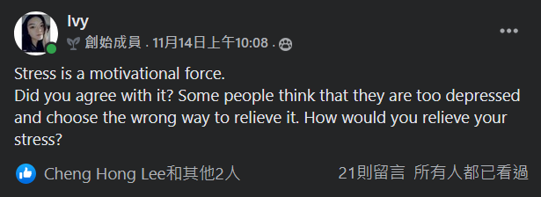
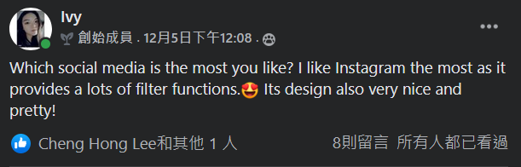
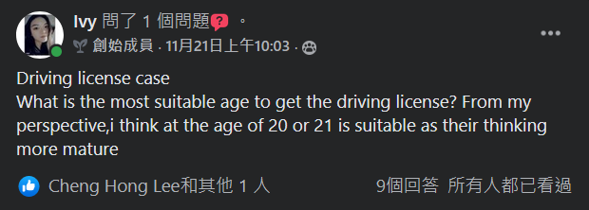
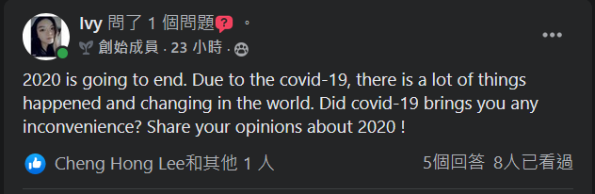
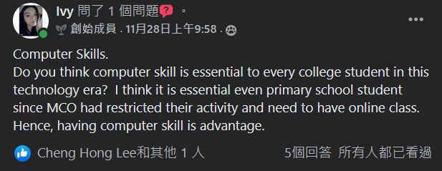
List of all posts
01
1

Slide 2
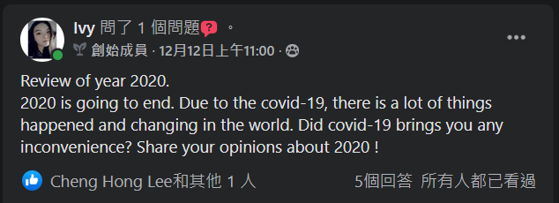
02
The Best Post :
We will recall everythings that we have done at every end of the year
For me, the most of things that I can recall is only stay at home with the online classes.
We only can stay at home to prevent the case increase.
Economy also going down.
We also discovered our insufficient ability.
2020 Teach us a lesson - cherish to what we have and the people around us.

Slide 3
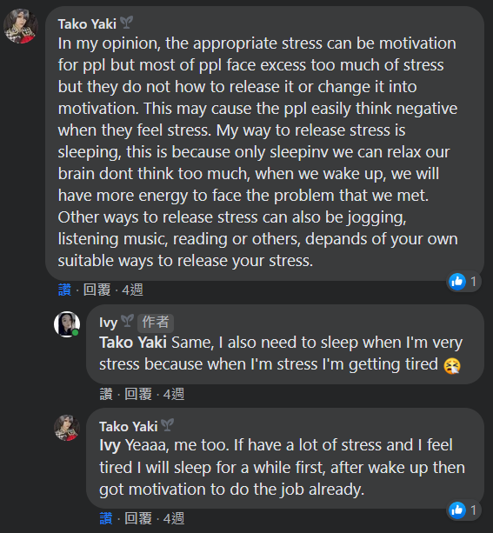
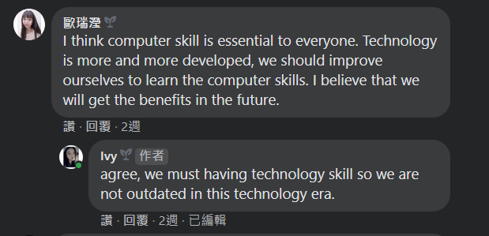
Two Best Comment:
03
Technology nowadays having improvement in every seconds.
If before MCO, every people already have the basic of computer skills, they might no need to worry about their job or class.
Stress has positive and negative.
It is important and essential to release our stress
Avoid from harm ourselves.​

Slide 4
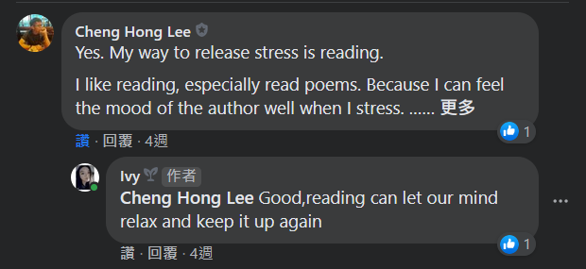
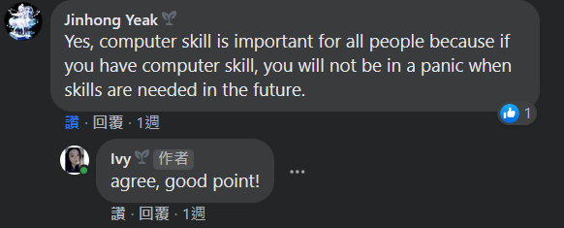
04
Fastest and Slowest comment
Picture at the left side is the fastest response.
He responses in about few minutes after posted.
Picture at the right is the slowest response. The posted comment is about a week after my post posted.

Slide 5
05
Language
Proper English and suitable punctuation used
Some emoji used to express their feeling.
Clear explaination given.
Support of the comment
Most of the comment are supportive but some not.
For example, the post about driving license case.
They not agree that driving license only can have until they 20 or 21.
This will make them Inconvenience and burden their family.

Slide 6
06
Conclusion
A way to communicate.
Know about others member.
Interaction important when communicate.
Obtain more knowledge and hot news.
Learn more from the comments given.
For example, the post which related to the mysejahtera.
Fuelling at the petrol station and scan the mysejahtera.
This is a issue which need to concern as using mobile phone at this kind of place will result in dangerous impact such as explosion.
English as a universal language
Response given with a clear explaination.

Slide 7
Appendix

Slide 8
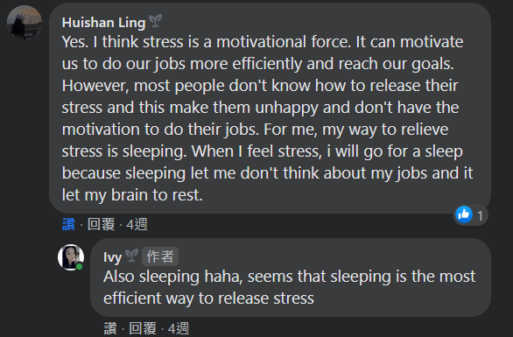
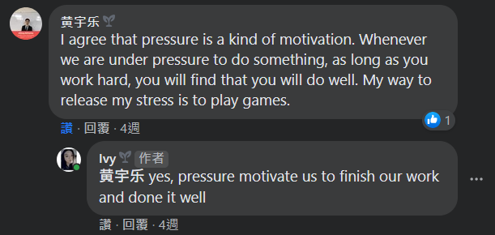

Slide 9
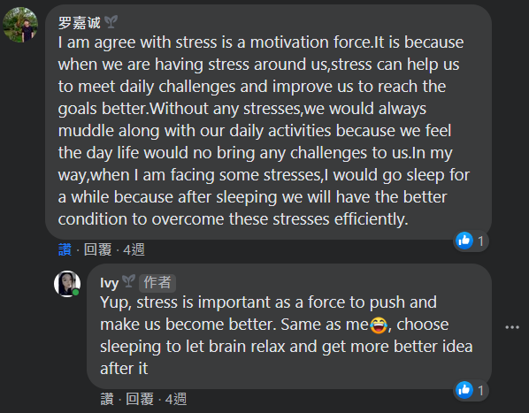
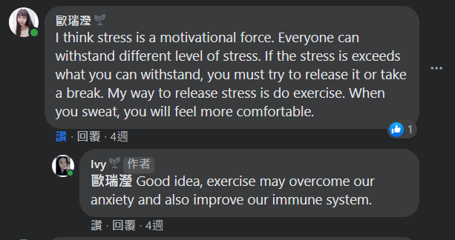

Slide 10
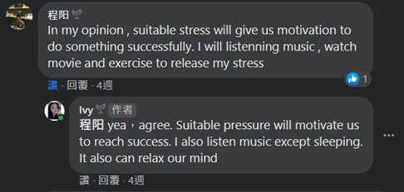
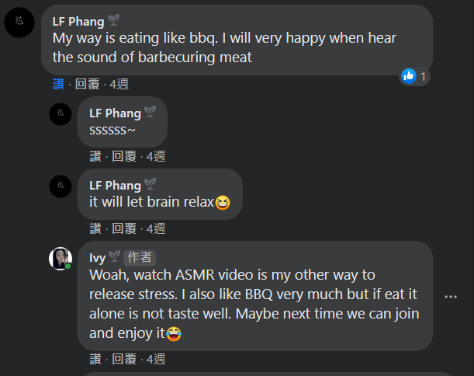
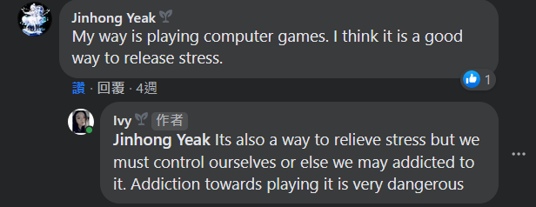

Slide 11
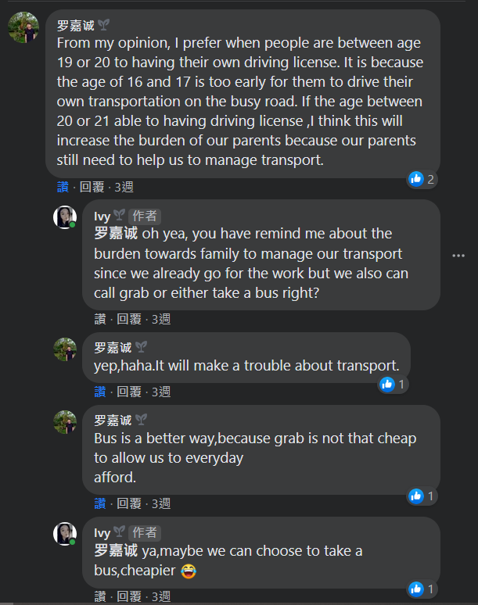
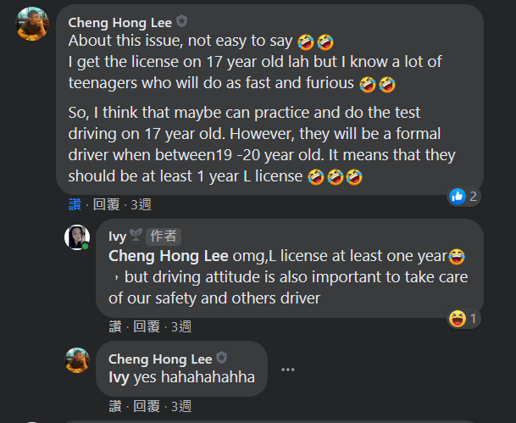

Slide 12
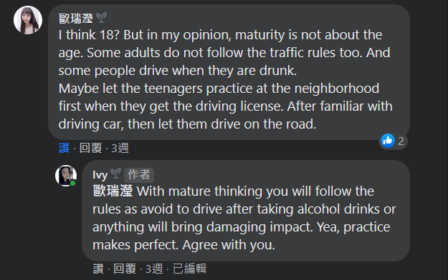
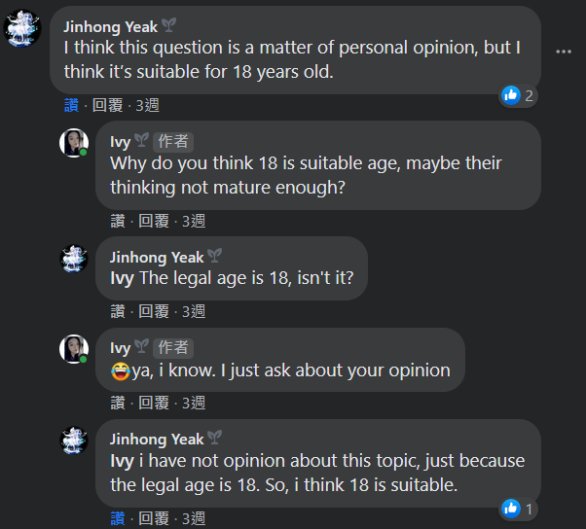
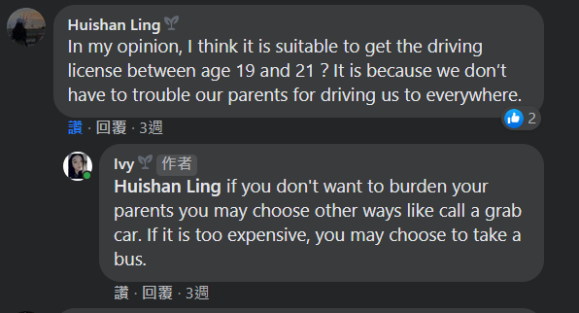
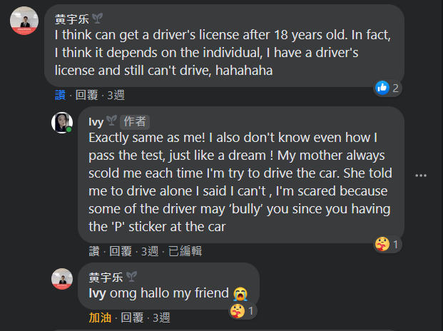

Slide 13
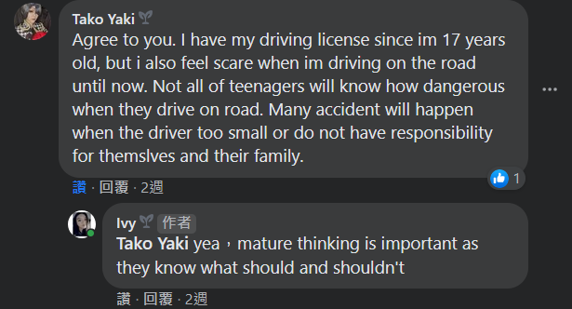
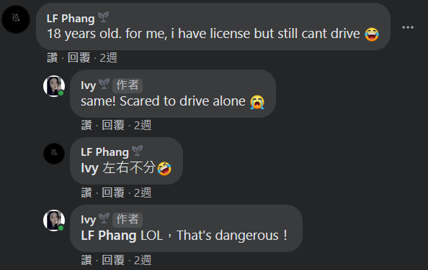
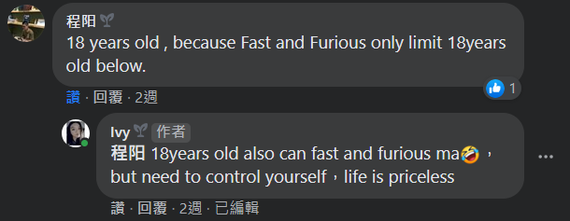

Slide 14
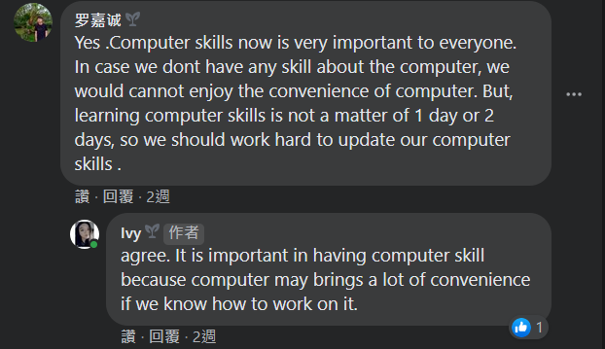
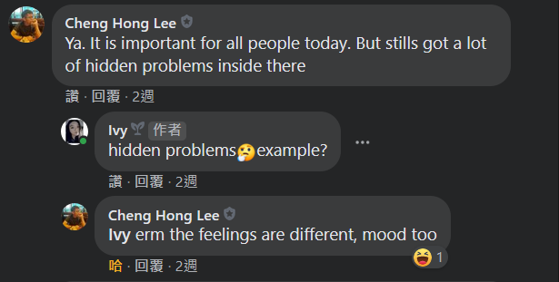

Slide 15
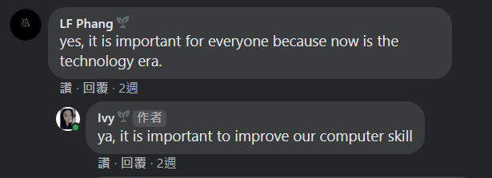

Slide 16
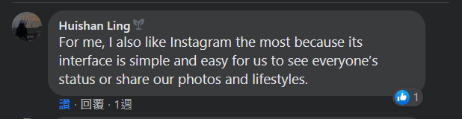
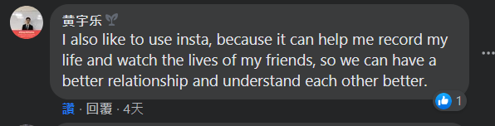
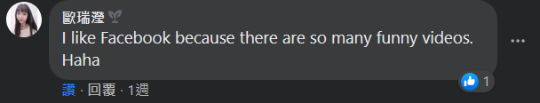
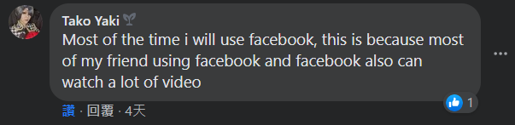
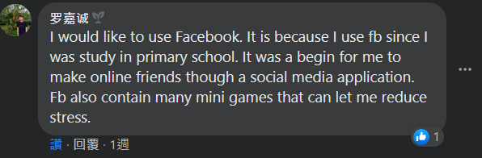
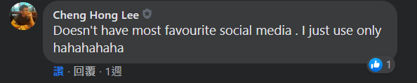
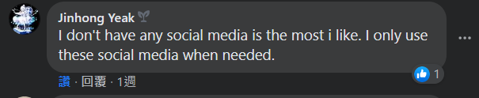

Slide 17
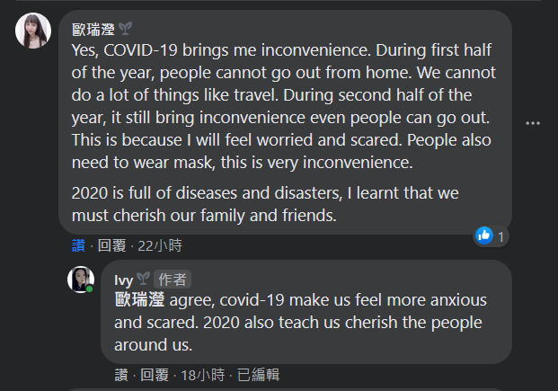
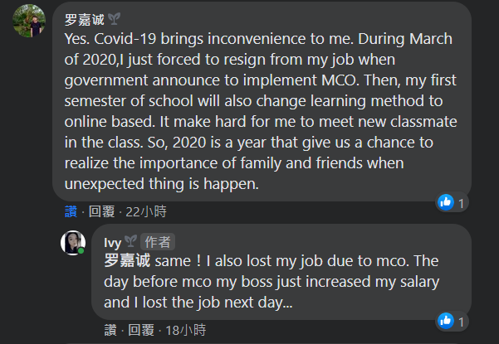

Slide 18
